Slide 1
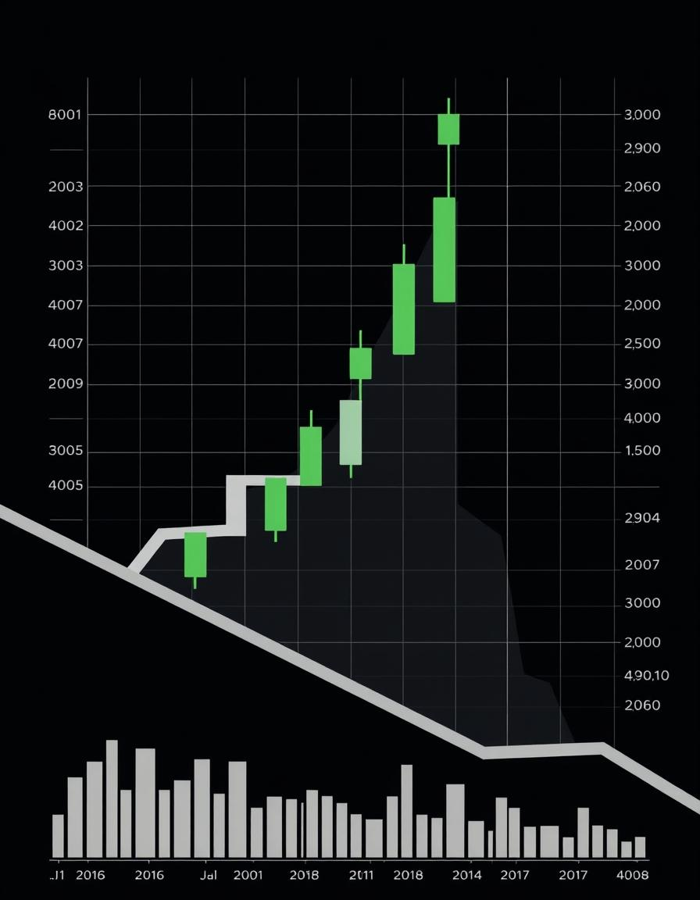

Tata Motors Stock Price Prediction (Time Series)
This presentation explores a descriptive, predictive, and prescriptive analysis of Tata Motors' stock price.
Nikhil Choudhary
MABSPG2023055

Slide 2
Agenda
Introduction- Overview of the project and objectives.
Descriptive Analysis- Understanding historical patterns in Tata Motors' stock prices.
Predictive Analysis- Forecasting future stock prices using the ARIMA model.
Prescriptive Analysis- Providing actionable recommendations based on the predictive analysis.
Conclusion- Summary of findings and future steps.

Slide 3
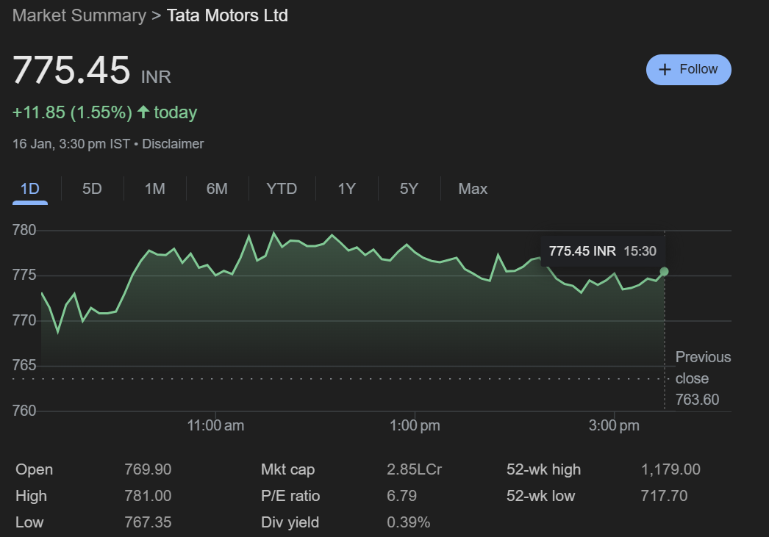
Introduction
Project Overview- Predicting Tata Motors' stock prices for the next 30 business days using the ARIMA model.
Objective- Apply time series forecasting techniques to analyze historical stock data and predict future price trends.
Tools Used- Python, ARIMA model (statsmodels), data visualization (matplotlib, pandas).

Slide 4
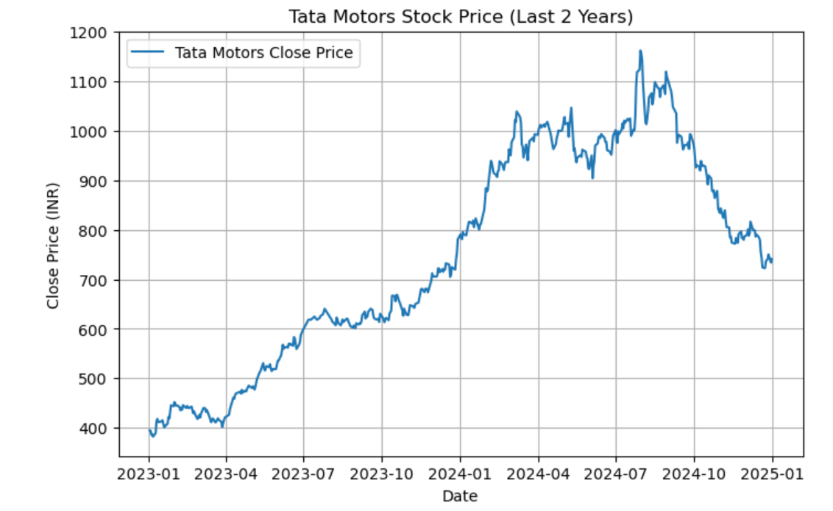
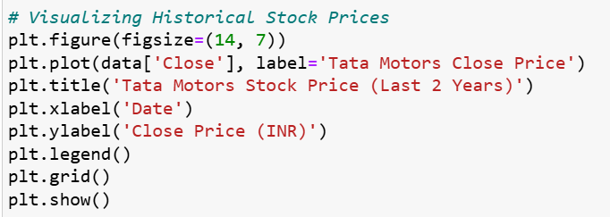
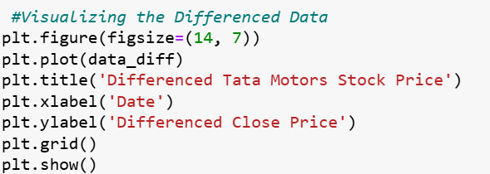
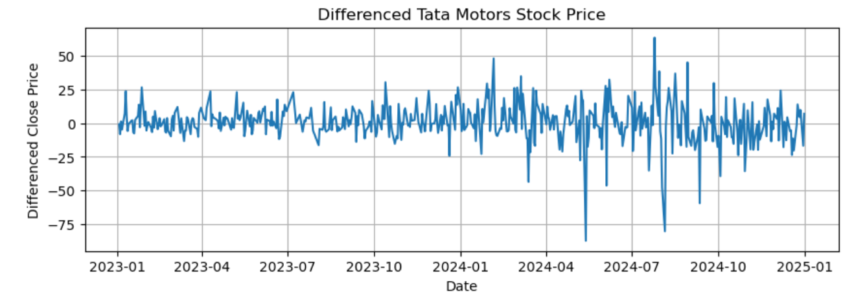
Descriptive Analysis (Understanding the Past)
Objective: Understand the behavior of Tata Motors stock price over the past 2 years.
Input -
Output -

Slide 5

Descriptive Analysis - Key Insights
Trend- Identified periods of high volatility (e.g., market crashes, major company events).
Volatility- Observed fluctuations and the periodicity of stock movements.
Stationarity- Stationarity was achieved after differencing, making it ready for ARIMA modeling.

Slide 6
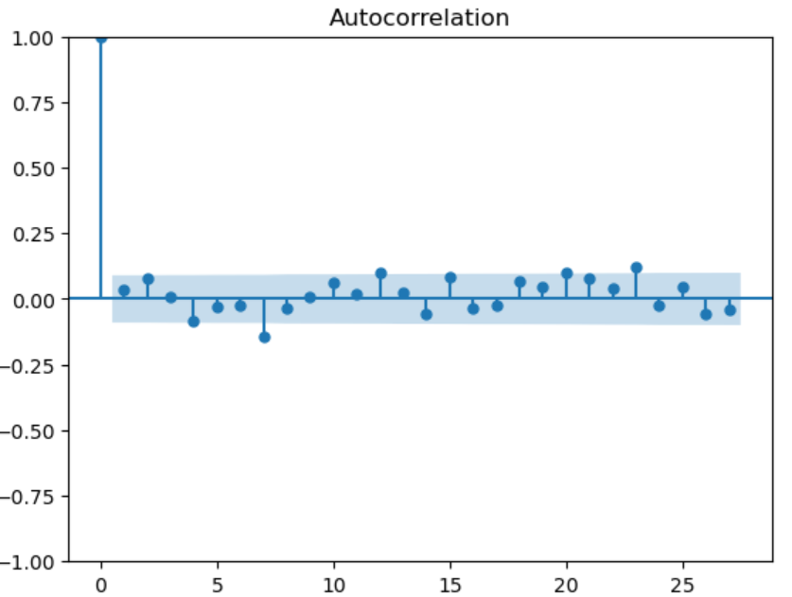
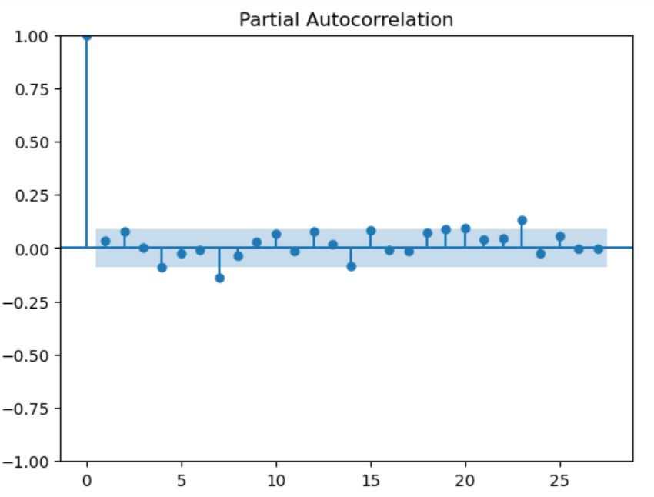
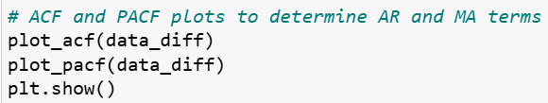
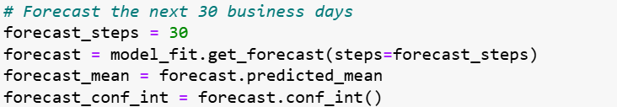
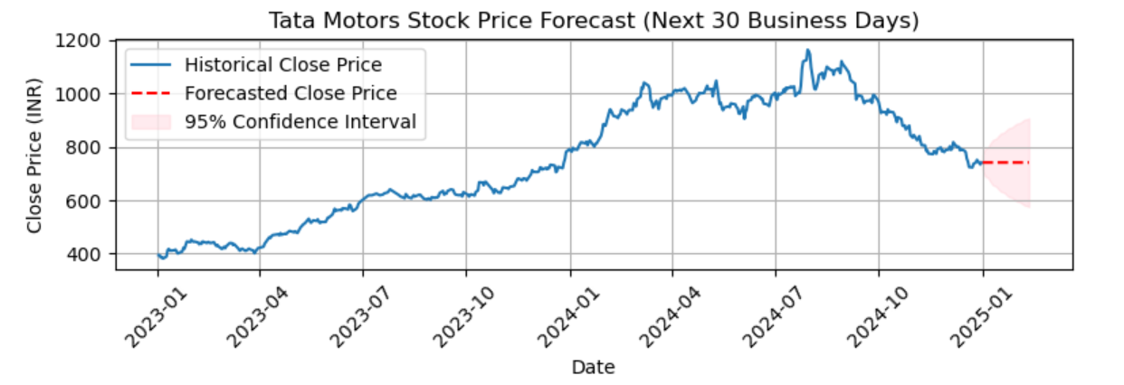
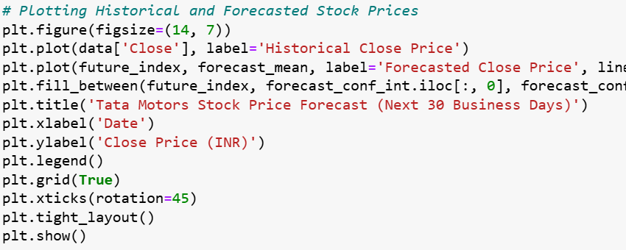
Predictive Analysis (Forecasting the Future)
Objective: Forecast the stock prices for the next 30 business days using ARIMA.
Input -
Output -

Slide 7
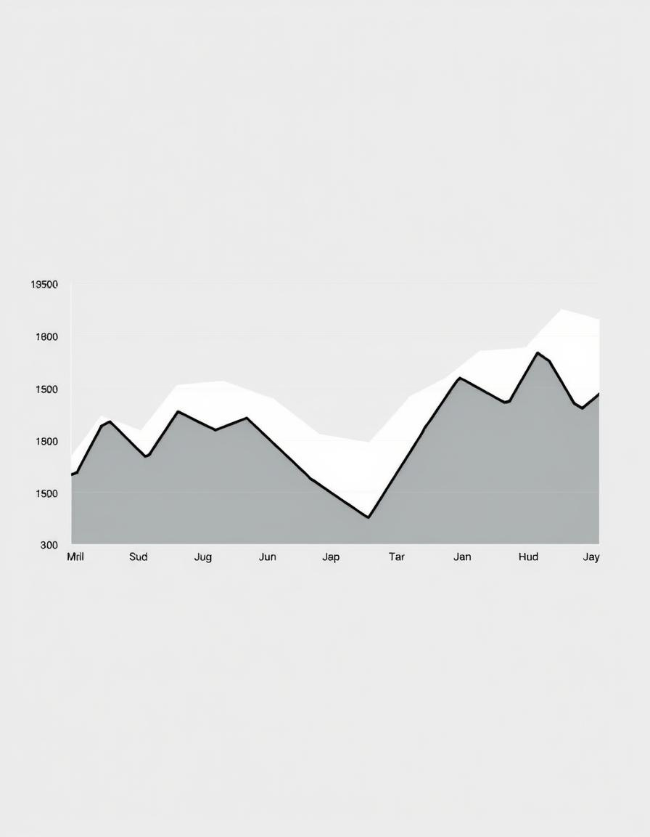
Predictive Analysis - Key Insights
Future Stock Price- The ARIMA model predicts a gradual increase in Tata Motors' stock price in the upcoming 30 days.
Uncertainty- Confidence intervals provide insight into the expected range of future stock prices, highlighting the uncertainty of predictions.

Slide 8
Prescriptive Analysis (Recommending Actions)
Objective:
Provide actionable recommendations based on the forecast for the next 30 business days.
Prescriptive Insights from the Forecast:
If the forecast indicates upward movement, investors could consider buying or holding.
If the forecast predicts a decline, investors might want to sell or wait for a better entry point.

Slide 9
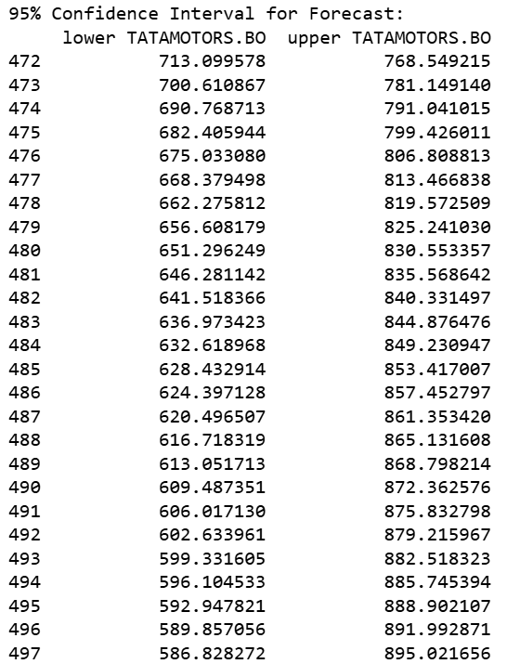
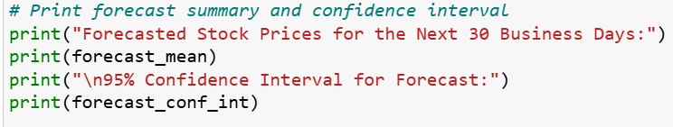
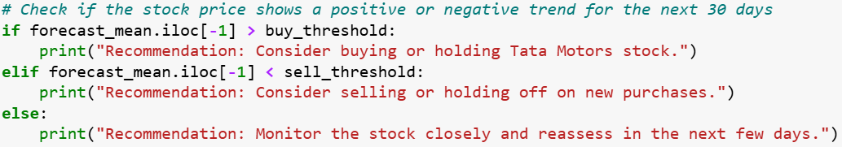
Recommending Actions based on Forecast
Input -
Output -

Slide 10
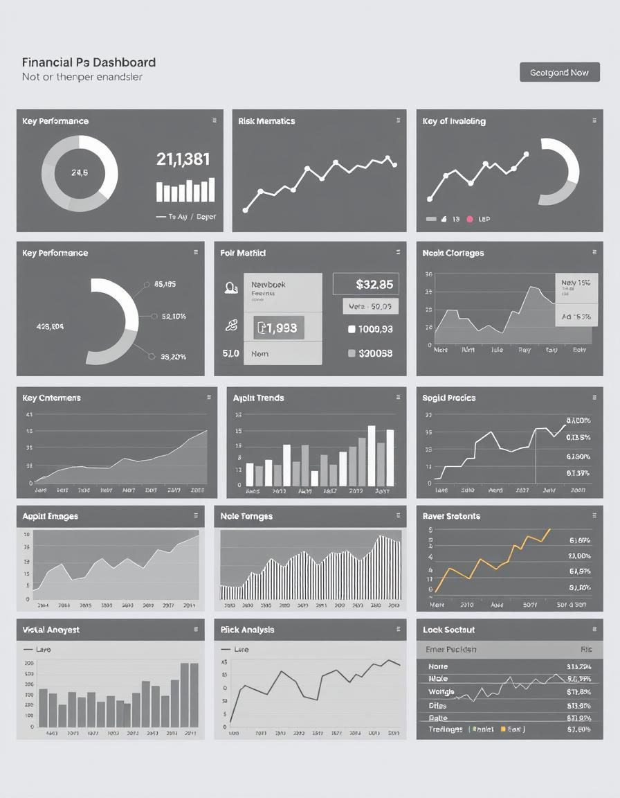
Preceptive Analysis - Key Insights
Investment Opportunities- Investors can consider the forecasted rise in Tata Motors' stock price.
Risk Management- Monitoring external factors (e.g., market news) that could impact the stock price.
Scenario Analysis- Understanding how different market conditions can affect future stock prices.

Slide 11
Conclusion
The ARIMA model successfully predicted Tata Motors’ stock price for the next 30 business days. Descriptive analysis helped understand the historical behavior of stock prices. Predictive analysis offered a forecast for future stock prices. Prescriptive analysis provided actionable insights for investors.

